Slide 1

Artificial Neural Network: Activation Function
Mina Farmanbar
Associate Professor, University of Stavanger
for engineers

Slide 2
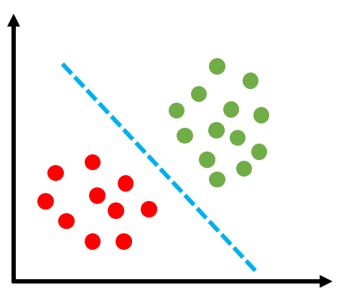
Activation Functions
We have data from two classes, our neuron can separate the two classes with a line.

Slide 3
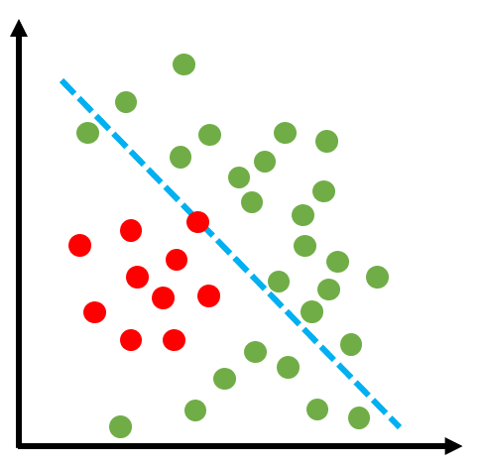
Activation Functions
You can see that the artificial neuron has tried its best to separate the green samples from the red ones. But it has done with a lot of error.

Slide 4
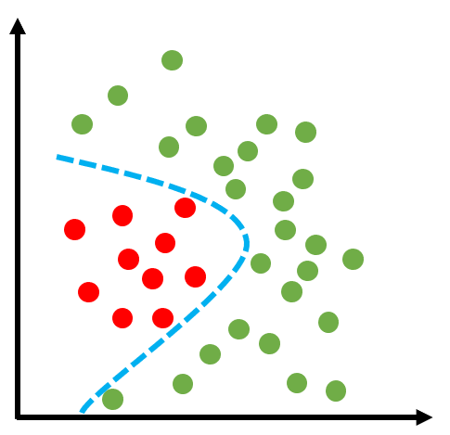
Activation Functions
If we ask you to draw a hypothetical line to separate these two classes, what would you draw?

Slide 5
Biological Neuron
Every single moment, our brain is trying to segregate the incoming information into the “useful” and “not-so-useful” categories.

Slide 6
Activation Function?
An Activation Function decides whether a neuron should be activated or not.
The primary role of the Activation Function is to transform the summed weighted input from the node into an output value to be fed to the next hidden layer or as output.

Slide 7
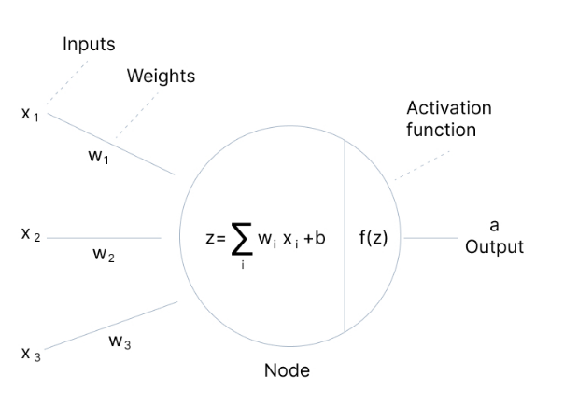
Activation Function?
The artificial neuron we defined works linearly.
Like the function y = ax
The activation function in the neural network is placed in the artificial neuron after the summation block denoted by f.
https://cdn.prod.website-files.com/5d7b77b063a9066d83e1209c/60d2412f8eda35fbd169d674_Group%20804.jpg

Slide 8
Types of Activation Function?
Well, the purpose of an activation function is to add non-linearity to the neural network.
Binary Step Function
Linear Function
Sigmoid Functions
Hyperbolic Tangent Function
ReLU (Rectified Linear Unit)
Leaky ReLU
Softmax Function

Slide 9
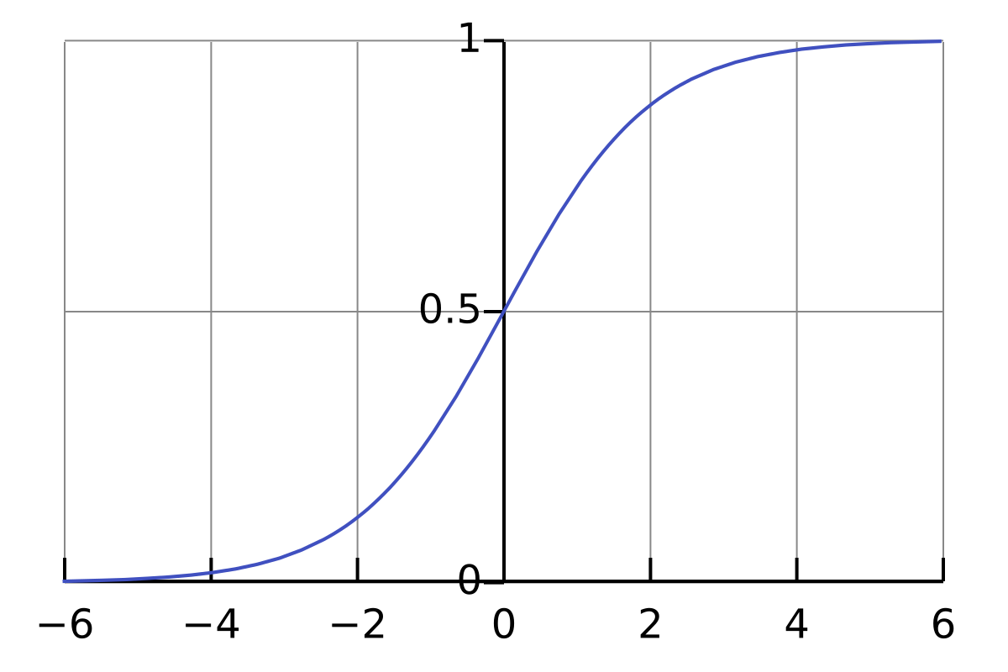
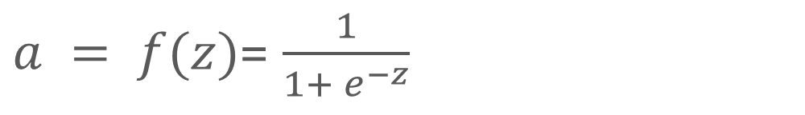
Sigmoid Function
$a = f(z)$= $\frac{1}{1+ e^{−z}}$

Slide 10
Sigmoid Function
The function is pretty flat beyond the +3 and -3 region.
When the function falls into that region, the gradients become very small, leading to the vanishing gradient problem.
As gradients approach zero, the network stops learning.

Slide 11
Sigmoid Function
Another problem with the sigmoid function is that the values only range from 0 to 1.
This means all its outputs are positive.
This means that the sigmoid function is not symmetric around the origin.

Slide 12
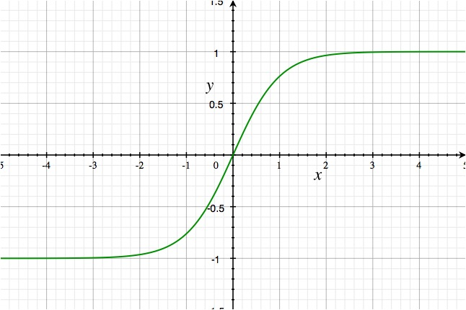
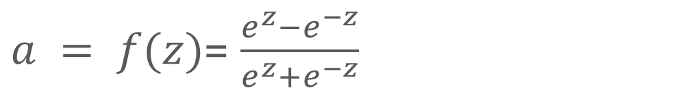
Hyperbolic Tangent Function
$a = f(z)$= $\frac{e^{z}−e^{−z}}{e^{z}+e^{−z}}$

Slide 13
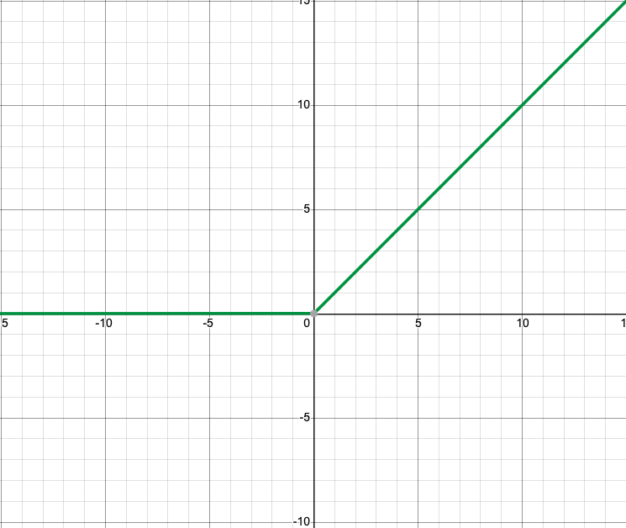
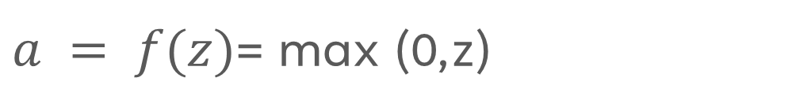
ReLU Function
$a = f(z)$= max (0,z)

Slide 14


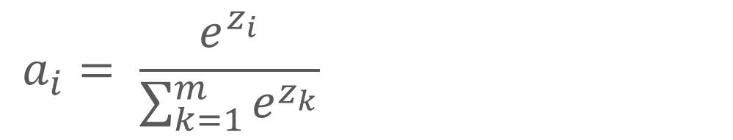
Softmax Function
Highest Probability
$$a_{i}= \frac{e^{z_{i}}}{\sum_{k=1}^{m}{e^{z_{k}}}}$$
Softmax
Activation Function
Output Layer
Probabilities

Slide 15
Summary
In conclusion, the sigmoid and the tanh functions are avoided in many applications nowadays since they can lead to the vanishing gradient problem.
The ReLU function is the function that's widely used, and it's important to note that it is only used in the hidden layers.
Finally, when building a model, you can use the ReLU function and then you can switch to other activation functions if the ReLU function does not yield a good performance.

Slide 16
Thank you!
Mina Farmanbar
mina.farmanbar@uis.no

